Slide 1
Operating System [ 4th-Semester]

Slide 2
Chapter 3.1 process concept

Slide 3
Process Concept
An operating system executes a variety of programs
batch systems - jobs
time-shared systems - user programs or tasks
Job, task and program used interchangeably
Process - a program in execution
process execution proceeds in a sequential fashion
A process contains
program counter, stack and data section

Slide 4
Process vs Program
program is a group of instructions to carry out a specified task.
A program is a passive entity, for example, a file accommodating a group of instructions to be executed (executable file).
Program is stored on disk in some file and does not require any other resources.
When a program is executed, it is known as process.
It is considered as an active entity and realizes the actions specified in a program.
Process holds resources such as CPU, memory address, disk, I/O etc.
Multiple processes can be related to the same program. It handles the operating system activities through PCB (Process control Block) which includes program counter, stack, state etc
A web browser launches multiple processes, e.g., one per tab

Slide 5
Text section is made up of the compiled program code, read in from non-volatile storage when the program is launched.
The Data section is made up the global and static variables, allocated and initialized prior to executing the main.
The Heap is used for the dynamic memory allocation, and is managed via calls to new, delete, malloc, free, etc.
The Stack is used for local variables. Space on the stack is reserved for local variables when they are declared.
Process in Memory

Slide 6
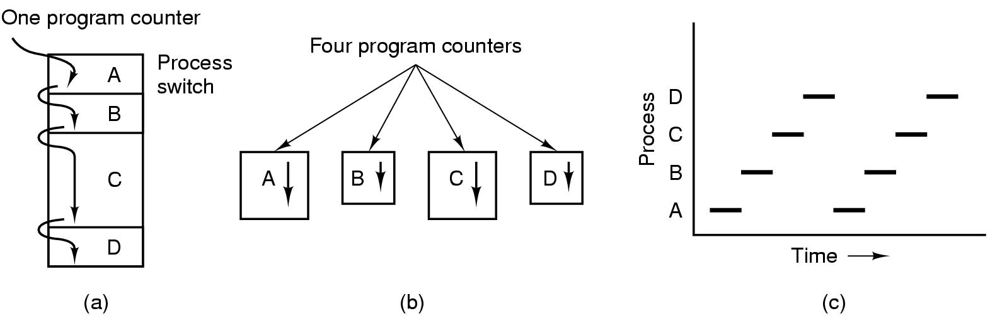
The Process Model
Figure 3-1. (a) Multiprogramming of four programs. (b) Conceptual model of four independent, sequential processes. (c) Only one program is active at once.

Slide 7
Conceptually, every process has its own virtual CPU but in reality CPU switches back and forth from process to process.
This Rapid switching back and forth is called "Multi-Programming.“
Multi-Programming
In this there is 4 program in memory. We have single shared processor by all programs.
There is only one program counter all programs in memory. In this program counter is initialized to execute the part of program A then with the help of process switch it transfer control to program B and execute some part of this.
After that program counter for program C is active and execute some part of it and so onto program D. Then all the steps continuous may be randomly with the help of process switches until all program is not completed.
One Program At One Time
At any given instant only one process run and other process after some interval of time.
In other point of view all processes progress but only process actually runs at given instant of time.

Slide 8
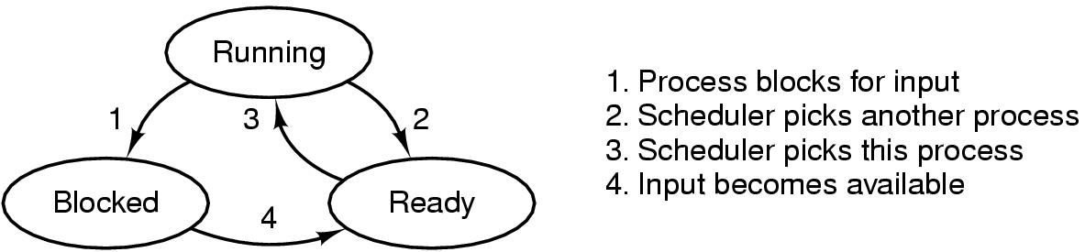
Process States
Three-state process model is constituted of READY, RUNNING & WAITING.
Running: the process is currently executed by the CPU
Blocked: the process is waiting for a resource to come available
Ready: the process is ready to be selected.

Slide 9
Five state process models
Figure 3-2. five-state Process State Transition Diagram

Slide 10
New : The process is being created.
Running : Instructions are being executed.
Waiting : Waiting for some event to occur(such as an I/O completion or reception of a signal).
Ready : Waiting to be assigned to a processor.
Terminated : Process has finished execution.
Preemptive scheduling allows a running process to be interrupted by a high priority process.
Non-preemptive scheduling, any new process has to wait until the running process finishes its CPU cycle.

Slide 11
Process suspension
Many OS are built around (Ready, Running, Blocked) states. But there is one more state that may aid in the operation of an OS - suspended state.
When none of the processes occupying the main memory is in a Ready state, OS swaps one of the blocked processes out onto to the Suspend queue.
Suspend ready: A process in the ready state, which is moved to secondary memory from the main memory due to lack of the resources (mainly primary memory) is called in the suspend ready state.
Suspend wait: Instead of removing the process from the ready queue, it's better to remove the blocked process which is waiting for some resources in the main memory.

Slide 12
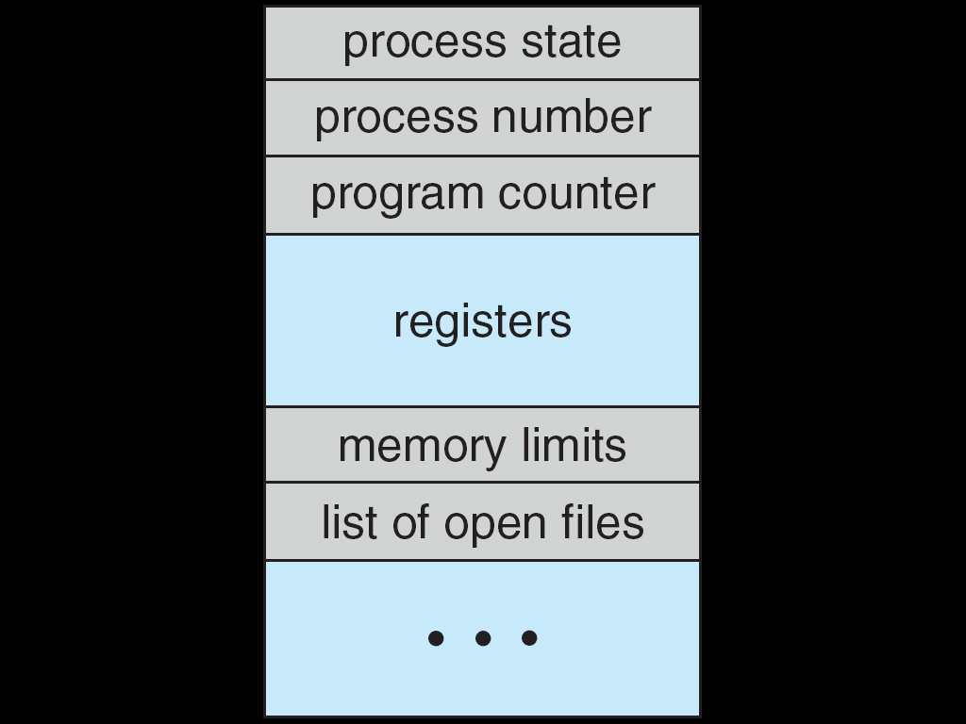
Process Control Block(PCB)
Each process is represented in the operating system by a process control block (PCB)-also called a task control block.
Process State - e.g. new, ready, running etc.
Process Number – Process ID
Program Counter - address of next instruction to be executed
Figure 3.3. Process control block (PCB).

Slide 13
CPU registers - general purpose registers, index registers, stack pointer etc.
CPU scheduling information - This information includes a process priority, pointers to scheduling queues, and any other scheduling parameters.
Memory Management information - This information may include such information as the value of the base and limit registers, the page tables, or the segment tables, depending on the memory system used by the operating system.
Accounting information - This information includes the amount of CPU and real time used, time limits, account numbers, job or process numbers, and so on.
I/O Status information - This information includes the list of I/O devices allocated to the process, a list of open files, and so on.

Slide 14
Process Creation
Events which cause process creation:
initialization of operating system
A user request to create a new process
Initiation of a batch job
Parent process create children process
Address space
Resource sharing

Slide 15
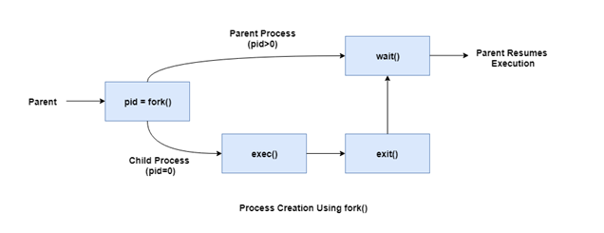
Process Creation

Slide 16
Process Termination
Events which cause process termination:
Normal exit (voluntary).
Error exit (voluntary).
Fatal error (involuntary).
Killed by another process (involuntary).
When a process is terminated, the resources that were being utilized by the process are released by the operating system.
When a child process terminates, it sends the status information back to the parent process before terminating.

Slide 17
Process Hierarchy
Modern general purpose operating system used to create and destroy processes. A process may create several new processes during its time of execution.
The creating process is called "Parent Process", while new processes are called "Child Processes".
There are different possibilities concerning creating new processes:-
Execution: The parent process continues to execute concurrently with its children processes or it waits until all of its children processes have terminated (sequentially).
Sharing: Either the parent and children processes share all resources (like memory or files) or the children processes share only a subset of their parent's resources or the parent and children process share number of resources in common.

Slide 18
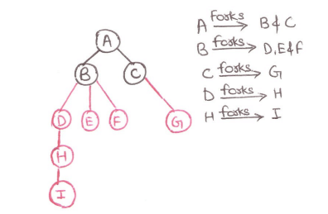
A parent process can terminate equation of one of its children for one of these reasons:
• The child process has exceeded its usage of the resources it has been allocated. For this a mechanism must be available to allow the parent process inspect the state of its children process.
• Task assigned to child process is no longer required.
In unix this is done by the'Fork' system call, which creates a 'child' process and the 'exit system call', which terminates current process.

Slide 19
Implementation of Processes
Process Model is implemented by Process Table and Process Control Block which keep track all information of process.
At the time of creation of a new process, operating system allocates a memory for it loads a process code in the allocated memory and setup data space for it .
The state of process is stored as ' new ' in its PCB and when this process move to ready state its state is also changes in PCB.
When a running process needs to wait for an input output devices, its state is changed to 'blocked'. The various queues used for this which is implemented as linked list.

Slide 20
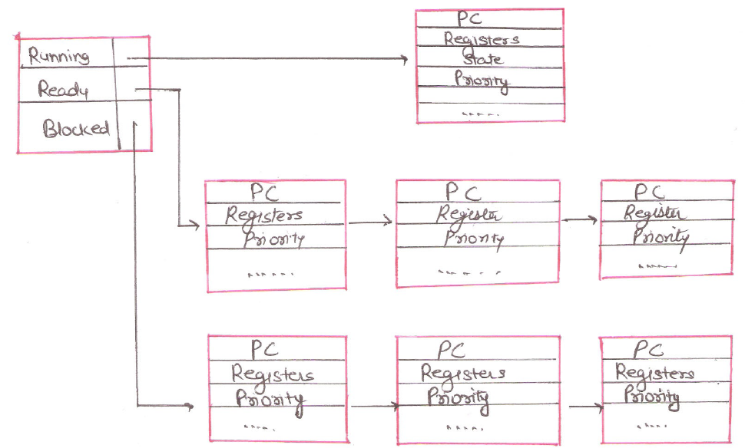

Slide 21
There are many following queues:
• Read Queue: This queue is used for storing the processes with state ready .
• Blocked Queue: it is used for storing the processes but need to wait for an input output device or resource.
• Suspended Queue: It is used for storing the blocked process that have been suspended.
• Free process Queue: it is used for the information of empty space in the memory where a new PCB can be created.

Slide 22
Cooperating Processes
There are two kinds of processes: cooperating and independent processes. A process is independent if it cannot affect or be affected by other processes. A process is said to be a cooperating process if it can affect or be affected by other processes in the system. A process that shares data with other processes is cooperating and a process that does not share data is independent.
Reasons for needing cooperating processes
Modularity
Modularity involves dividing complicated tasks into smaller subtasks. These subtasks can completed by different cooperating processes. This leads to faster and more efficient completion of the required tasks.
Information Sharing
Sharing of information between multiple processes can be accomplished using cooperating processes. This may include access to the same files. A mechanism is required so that the processes can access the files in parallel to each other.
Convenience
There are many tasks that a user needs to do such as compiling, printing, editing etc. It is convenient if these tasks can be managed by cooperating processes

Slide 23
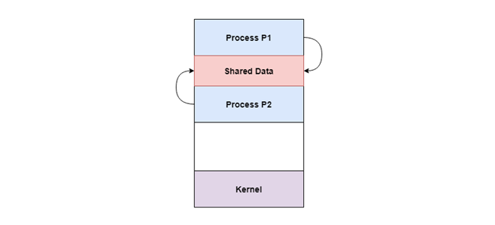
Reasons for needing cooperating processes
Computation Speedup Subtasks of a single task can be performed parallely using cooperating processes. This increases the computation speedup as the task can be executed faster. However, this is only possible if the system has multiple processing elements.
Methods of Cooperation
Cooperation by Sharing
The cooperating processes can cooperate with each other using shared data such as memory, variables, files, databases etc.
In the above diagram, Process P1 and P2 can cooperate with each other using shared data such as memory, variables, files, databases etc.

Slide 24
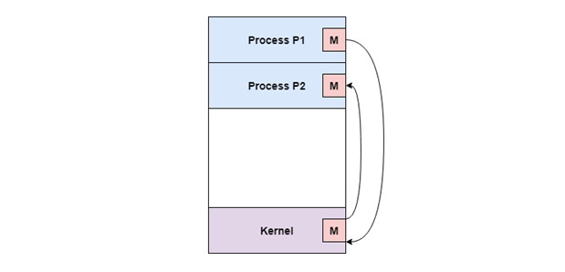
Methods of Cooperation
Cooperation by Communication
The cooperating processes can cooperate with each other using messages.
In the above diagram, Process P1 and P2 can cooperate with each other using messages to communicate.

